Slide 1
OpenDiabetesVault: Data Gathering and Data Slicing Algorithms
MSc. Thesis Presentation by
Ankush Chikhale
Supervisor - Jens Heuschkel
21 September 2017

Slide 2
CONTENT
Introduction
Crawler Algorithm
Applet Wrapper Algorithm
Combining Crawler and Wrapper
Data slicer Algorithm
Unit Testing
Conclusion
2

Slide 3
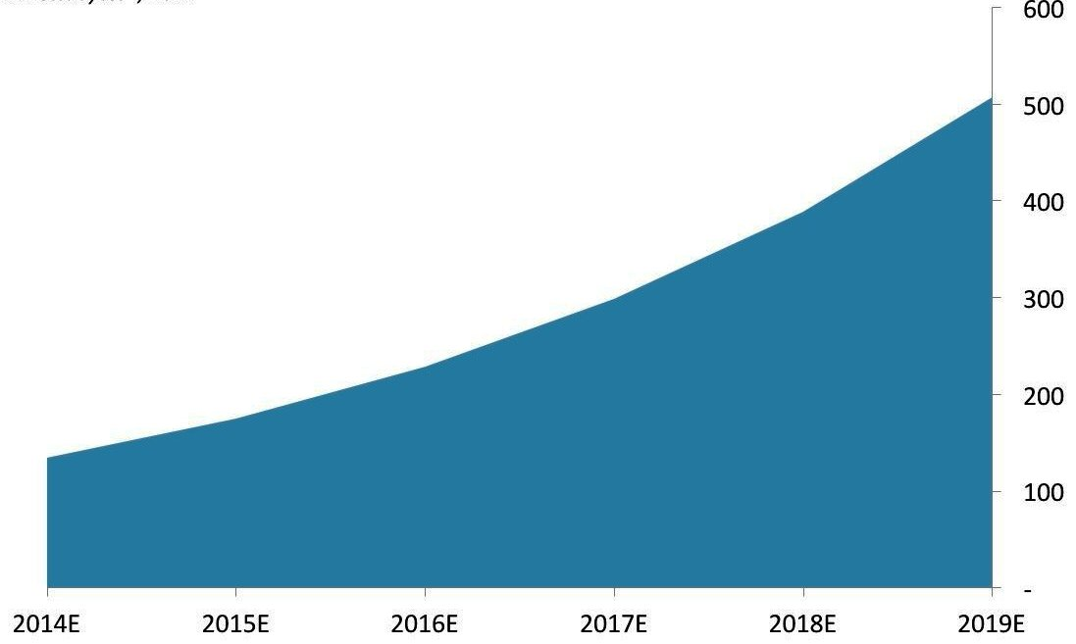
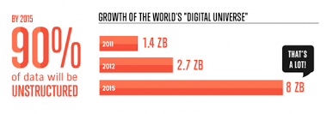
Introduction
Volume of data being created is growing every year
According to Forbes, by the year 2020 the amount of generated data will be 44 trillion gigabytes.
One of the biggest challenges is to handle the huge amount of data and gain information from them.

Slide 4
Introduction
Motivation:
Researchers at TK have undertaken a project for analyzing medical data.
By analyzing medical data, researchers wish to generate patterns/ Trends.
Basic steps of Data mining/analysis is to have a big set of data.
Notes:
Why big set of data for data mining?
Ans: Well not always big set of data is needed for generating patters.
But particularly for the problem statement Researchers at TK wish to solve, needs large data set.

Slide 5
Introduction
Motivation:
Where do we get this huge data from?
Crawler Carelink Website
Google Maps Timeline
Smartband App
Glucosio Plugin
During this thesis work, we concentrated on data extraction from the Crawler Carelink Website only.
Once data extraction step is done, This data has to be filtered/sliced to the requirement of the problem statement.
Parallel to developing new algorithms, Unit testing of each module has been taking place.

Slide 6
Introduction
Goal and Contribution:
To develop algorithms for extracting and uploading bulk amount of data from and to Carelink website.
To develop algorithm for cleaning huge data set concerning the expected data.
To build unit test cases for data extraction and data cleaning algorithms.

Slide 7
Crawler Algorithm

Slide 8
Proof of Concept- Crawler
Carelink Website:
This Web-based system is designed to help you take information from all of your diabetes management tools – your insulin pump, continuous glucose monitor, blood glucose meter(s), and logbook – and organize it into easy-to-read charts, graphs and tables.
These reports can help you and your healthcare provider discover trends and other information that can lead to improved therapy management for greater control.
https://carelink.minimed.eu/

Slide 9
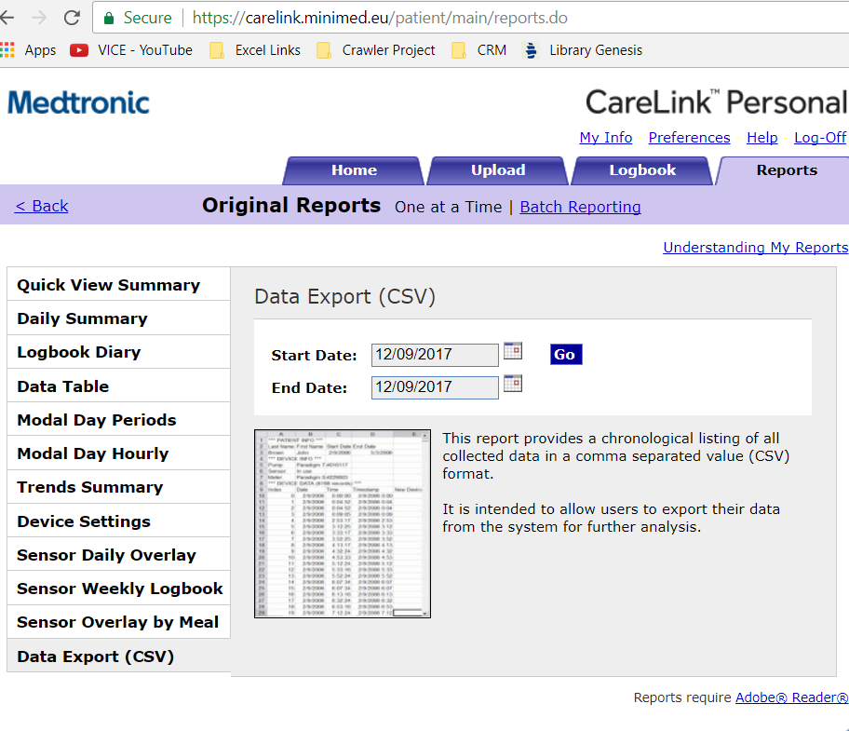
Proof of Concept- Crawler
Report page in browser from where report has to be fetched is shown in screenshot.
To reach to this Page, User has to Login into Website.
We need Program logic to bypass the User Agent which will use Cookies to keep Session and download in bulk.
https://carelink.minimed.eu/

Slide 10
Crawler – Technologies used
Programming Language and Libraries:
Programming Language used is Java
As programming language is decided, which all libraries in Java will help with Crawling
Library | Short Description
Jsoup | Jsoup is a Java library working with real-world HTML
Jaunt API | Jaunt is a new, free, Java library for web-scraping & web-automation, including JSON querying.
HtmlCleaner | HtmlCleaner is an open source HTML parser written in Java.
Jtidy | JTidy is a Java port of HTML Tidy, a HTML syntax checker and pretty printer. Like its non-Java cousin, JTidy can be used as a tool for cleaning up malformed and faulty HTML.
NekoHTML | NekoHTML is a simple HTML scanner and tag balancer that enables application programmers to parse HTML
TagSoup | TagSoup is a library for parsing HTML/XML
https://en.wikipedia.org/wiki/Comparison_of_HTML_parsers
Notes:
Why Java?
Entire Openvalut Framework is built in Java.
Framework to be written in Java was decided by Mr.Jens
Crawler4j is an open source Java crawler which provides a simple interface for crawling the Web. You can setup a multi-threaded web crawler in few hours.

Slide 11
Crawler – Jsoup
Jsoup:
Jsoup is a Java library working with real-world HTML.
It provides a very convenient API for extracting and manipulating data.
Jsoup implements the WhatWG HTML5 specification.
It parses the HTML to the same DOM as modern browsers do.
scrape and parse HTML from a URL, file, or string
Find and extract data, using DOM traversal or CSS selectors
Manipulate the HTML elements, attributes, and text
clean user-submitted content against a safe white-list to prevent XSS attacks
output tidy HTML
It does have good online community support.
https://jsoup.org/

Slide 12
Proof of Concept- Crawler
Login Functionality:
First step is to login programmatically
j_username and j_password are the field names deducted from inspecting Dom object.
With the help of these field names and using Jsoup, login is possible.
Cookies will be saved which will be further used to manipulate dates for Csv report.
Connection.Response res = Jsoup.connect("https://carelink.minimed.eu/patient/j_security_check").data("j_username", username).data("j_password",password).method(Connection.Method.POST).execute(); loginCookies = res.cookies();
Notes:
GET - Requests data from a specified resource
POST - Submits data to be processed to a specified resource

Slide 13
Proof of Concept- Crawler
Date validation for CSV:
Date format should be DD/MM/YYYY for user with English as base language and DD.MM.YYYY as German a base language.
In our current work we have restricted our support to users using only English and German language.
Start date and end date should not be before 01/01/1998 (01.01.1998)
The start date should not be greater than end date.
Start date and end date shall not be greater than Today's date.
Connection.Response ReportDocument = Jsoup.connect("https://carelink.minimed.eu/patient/main/selectCSV.do?t=11?t=11?t=11?t=11")
.timeout(60000).cookies(loginCookies).data("report", "11").data("listSeparator", ",")
.data("datePicker2", startDate) // start date
.data("datePicker1", endDate) // End date
.method(Connection.Method.GET).execute();
Notes:
if(loginCookies.toString().contains("locale=de")){
return "de";
}else if(loginCookies.toString().contains("locale=en")){
return "en";
}

Slide 14
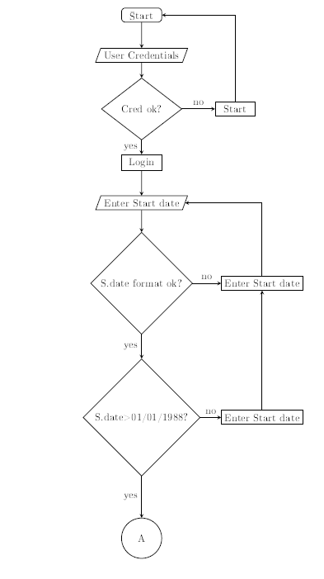
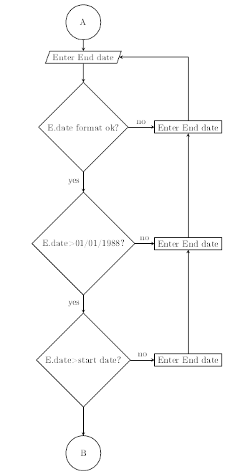
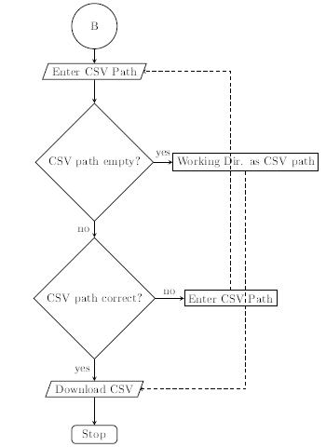
Crawler- Flowchart

Slide 15
Applet Wrapper Algorithm

Slide 16
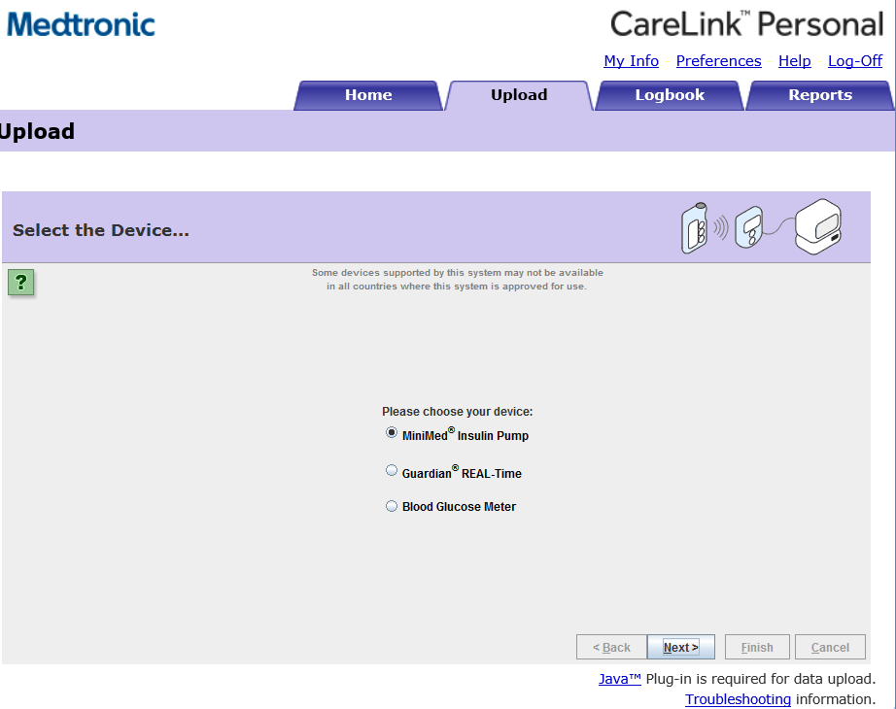
Applet Wrapper
After successful Proof of concept with crawler, next step was to upload data to Crawler website.
Upload section in Carelink website has been implemented with Applet.
Intital Idea of this task was to take the applet out of browser, i.e. to run applet with login cookies generated with Jsoup.
But We faced technical difficulties here, using Cookies for Applet.
The applet uses its own cookies generated for browser.
This was technical roadblock and hence we came up with idea of simulation
https://docs.oracle.com/javase/tutorial/deployment/applet/index.html
Notes:
I think your problem is that your applet not accomplish security requirements. According to oracle documentation: To access cookies, you must sign your applet JAR file and request permission to run outside of the security sandbox.

Slide 17
Applet Wrapper - Browser automation Tools
Moving forward We implemented the Concept of browser automation.
There are numerous Browser Automation Tools available such as
Kantu
QF-Test
Sahi
SOAtest
iMacros
Selenium
Notes:
There are numerous browser automation tools available such as Kantu, QF-Test, Sahi, SOAtest, iMacros,
Selenium and so on. Kantu can automate website by taking screenshots. It helps to visually automate
tasks and makes web automation interesting. Using Kantu solutions can be created for web automation,
web scraping or web testing in just few minutes. It works on the visual website similar to how we human
does. Kantu's visual approach speeds up web automation projects tenfold. But Kantu uses only screen
shots as scripting language and not CSS or DOM object which is needed in our project work. QF-Test is
a cross platform software tool for the GUI test automation and specializes in automating test cases rather
than any implementation of a Task. QF-Test's capture/replay function enables recording of tests for
beginners, while modularization allows for creating large test suites in a concise arrangement. QF-Test
uses visual scripting, Jython and Groovy as scripting language. Sahi uses it's own Sahi script whereas
Selenium supports Ruby, Java, NodeJS, PHP, Perl, Python, C#, Groovy as scripting language.
In addition, the web driver provided by Selenium for Internet Explorer is very reliable, sophisticated
and most important it is Open source. Because of added advantage, selenium was chosen to work on.
Selenium[11] is a browser automation tool; mostly used to simulate user interaction on web applications.
The browser control is automated so that repetitive tasks can be easily achieved with it. One of Selenium's
key features is the support for executing one's tests on multiple browser platforms. Selenium, is a
combination of selenium IDE, selenium Web driver and selenium gird. Selenium grid helps to use the
selenium APIs to control browser instances distributed over a grid of machines. Selenium IDE is an
extension for Firefox used to record and playback tests. Selenium uses lot of Jargon.

Slide 18
Applet Wrapper-Selenium
Selenium supports Ruby, Java, NodeJS, PHP, Perl, Python, C#, Groovy as the scripting language.
The web driver provided by Selenium for Internet Explorer is very reliable, sophisticated .
It is Open source.
With recent browser upgrades except Internet Explorer, no other browser other than Internet Explorer supports Applet.
This was also a major motivation to choose Selenium.

Slide 19
Proof of concept-Applet Wrapper
To run Selenium for IE browser, Selenium IE web drivers need to be installed on machines.
This created an added dependency of installing Webdriver prior hand.
We bypassed this dependency with adding IEwebdriver.exe into our project folder.
If a user runs our Java program as a jar file, it is added into Jar file as well.
Hence this will reduce one step of dependency.
System.setProperty("webdriver.ie.driver", fileWhereIEDriverislocated.getAbsolutePath());
driver = new InternetExplorerDriver(capabilities);
driver.manage().window().maximize();
driver.get("https://carelink.minimed.eu/patient/entry.jsp?bhcp=1");
Notes:
if (location.startsWith("rsrc:") || location.endsWith(".jar")
&& !new File(location.substring(location.indexOf(':') + 1)).isDirectory()) {
logger.info("(Inside Method Startmagic) Running from Jar file ");
Here is the Stackoverflow which helped me out.
------------------------------------------------
Runtime.getRuntime().exec("C:\\Program Files\\Internet Explorer\\iexplore.exe https://carelink.minimed.eu/");
Runtime.getRuntime().exec("iexplore.exe www.stackoverflow.com"); /// gives you error if path is not set or if IE is not your default browser.

Slide 20
Proof of concept-Applet Wrapper
Login:
Using selenium and it‘s driver properties login is performed and thereon login page appears
During each operation with selenium we have an waiting time of 2-3 seconds because sometimes it takes time to load a page.
Below is the code snippet for entering login details and
driver.findElement(By.id("j_username")).sendKeys(loginName); driver.findElement(By.id("j_password")).sendKeys(loginPassword);
driver.findElement(By.id("j_password")).sendKeys(Keys.ENTER);
In a similar fashion upload section is clicked with Selenium
driver.findElement(By.id("upload")).sendKeys(Keys.ENTER);

Slide 21
Proof of concept-Applet Wrapper
Upload:
Once the upload page is clicked, Applet will appear.
DoM object manipulation is not possible here as it appears static.
Hence we used Robot class in Java to simulate user kepypressed events such as ALT+N(Next) Alt+B(back) and so on.
Which Key combination to press depends on user language chosen.
Depending on what logic needs to be performed, buttons are clicked and theron upload functionality can be completed.

Slide 22
Applet Wrapper- Validating options
What all options are available:
#Device for pump communication. Available options are: stick, bgdevice
#Select Pump Type. Available options are: Minimed, Paradigm
#Serial number of the pump you upload data from. 10 characters for Minimed 600 pumps. 6 characters for Paradgim pumps
Depending on which device selected, combination of Keys to simulate user changes as well.
Validation also needs to be done for serial number entered.
All the three options are needed to run Applet wrapper.

Slide 23
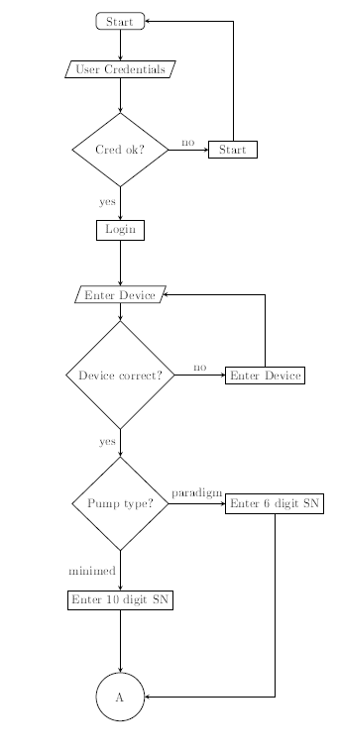
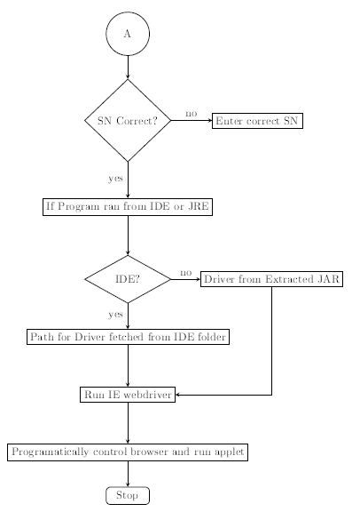
Applet Crawler - Flowchart

Slide 24
Combining Crawler and Wrapper

Slide 25
Combining Crawler and Wrapper
Two independent modules were successfully created, but how to club them in a framework
We came up with an Idea of using Config file.
What will config file contain:
User name and password (Ofcourse hashed ☺)
Path to save CSV data (optional)
Different options for Applet wrapper

Slide 26
Options to run a Java program
Let us first look at how one would run this Java program with different combinations together
We have used Commons CLI (Apache Commons) external libraries.
Version: Carelink Crawler v0.1
Options: -v,--version show program's version number and exit
-h, --help show this help message and exit
-i, --init FILE initializes a new config file at the given path.
-c, --config FILE defines the used config file.
-o,--output-path FILE defines output path (Default is ./).
-crawler starts in crawler mode. -from and -to is required.
-from defines start time point for the dataset.
-to defines end time point for the dataset.
-u, --upload starts in upload mode.
Combination to initilize a program : java -jar XYZ.jar -i,--init
Combination to run upload program : java -jar XYZ.jar -c or --config completepathwithfilename -u,--upload
Combination to run crawler program : java -jar XYZ.jar -c,--config completepathwithfilename -crawler -from 15/05/2017 -to 20/06/2017 --output outputfolderpath
Date Format:
English: DD/MM/YYYY
German: DD.MM.YYYY

Slide 27
Config file Example
#Username for access on http://carelink.minimed.eu
UserName: chikhalehero
#Password for access on http://carelink.minimed.eu
Password: qdoKzKHZndaYFc3O1/Z7/g==:M4h2mVYzeivqJMwaU9xeaw==
#Device for pump communication. Available options are: stick, bgdevice
Device: stick
#Select Pump Type. Available options are: Minimed, Paradigm
Pump: Minimed
#Serial number of the pump you upload data from. 10 characters for Minimed 600 pumps. 6 characters for Paradgim pumps
SN: 1234567890 #SN Number should be of 10 characters (alpha numeric only)
Notes:
logger.info("Inside Class CreateSecurePasswordClass, Method createHash");
String userkey = username;
// The salt (probably) can be stored along with the encrypted data
byte[] salt = new String("12345678").getBytes();
// Decreasing this speeds down startup time and can be useful during
// testing, but it also makes it easier for brute force attackers
int iterationCount = 40000;
// Other values give me java.security.InvalidKeyException: Illegal key
// size or default parameters
int keyLength = 128;
SecretKeySpec key = createSecretKey(userkey.toCharArray(), salt, iterationCount, keyLength,logger);
String originalPassword = password;
String encryptedPassword = encrypt(originalPassword, key);
String decryptedPassword = decrypt(encryptedPassword, key,logger);
return new String[] { encryptedPassword, decryptedPassword };

Slide 28
Data slicer Algorithm

Slide 29
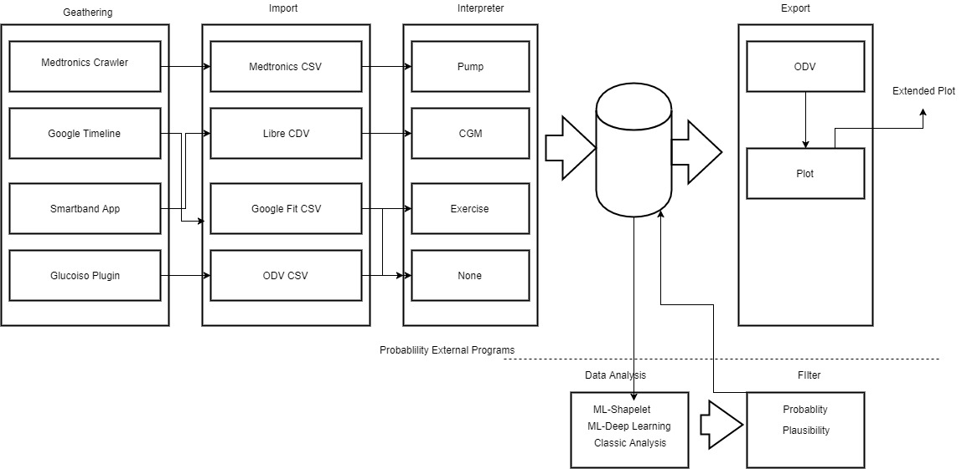
OpenVault Architecture
https://github.com/OpenDiabetes/OpenDiabetesVault-engine/wiki/Architecture
Notes:
The OpenDiabetesVault architecture follows a (gather,) import, process, export(, visualize) approach (illustrated by the figure below).
Gather Data: Currently we are not able to geather data automatically.
Import Data: Currently we support several devices for data import: Medtronic CSV, Freestyle Libre CSV, Google Fit CSV, Sony Smartband 3 SWT12 database dumps. Every importer works in two stages: parsing and interpretation. A parser reads values from one data point and converts it into the internal data format. The interpreter annotates data points and does very basic filtering on a data series. It also adds semantic implications (e.g. when a pump suspend is read, the interpreter would add a basal value 0).
Process Data: Currently we have no data processing implemented.
Export Data: Data can be exported to our csv data format. Also, a compressed (deflate) and signed format is available ".odv" (it's basically a zip archive with the csv file and signature file). Furthermore slicing (produced by the DataSlicer) information can be exported as csv for our plotting script.
Visualize Data: The odv-CSV data can be visualized by our plotting script using matplotlib (separate project).

Slide 30
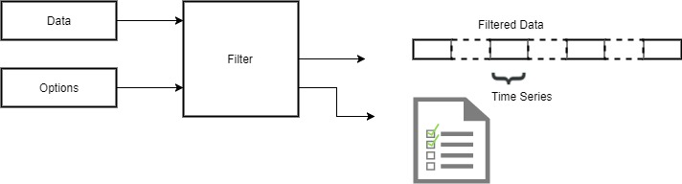
Data Filtering
For data filtering we provide the Filter interface.
Filters can be registered at processing services like the DataSlicer and have to implement the Filter interface.
Multiple filters are combined with the logical "and" paradigm.
https://github.com/OpenDiabetes/OpenDiabetesVault-engine/wiki/Data-Filtering
Notes:
For data filtering we provide the Filter interface. Filters can be registered at processing services like the DataSlicer and have to implement the Filter interface. Multiple filters are combined with the logical "and" paradigm. As shown in the figure below, filters take a data array together with options. The filter will delete not matching data from the array and returns it together with a list of time spans where continuous data is present (this could be used to find the data in the complete array again)

Slide 31
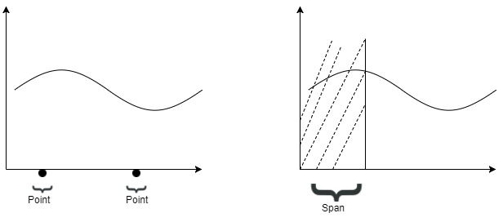
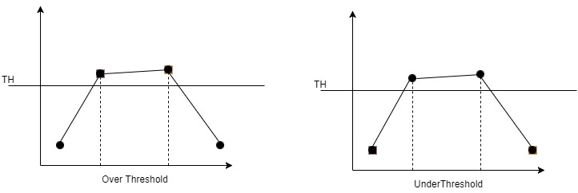
Data Filtering- Types
Time Related Filter: This kind of filters is used to find a time point or a time span where some kind of event happened or some kind of data is available or not available. For instance, if you want to check the basal insulin rate you search for time spans where no bolus is given. Filters of the time point type should provide a margin option enable data observation around the
Threshold-Related Filter: This kind of filter are used to find data over or under a certain threshold.
https://github.com/OpenDiabetes/OpenDiabetesVault-engine/wiki/Data-Filtering
Notes:
For data filtering we provide the Filter interface. Filters can be registered at processing services like the DataSlicer and have to implement the Filter interface. Multiple filters are combined with the logical "and" paradigm. As shown in the figure below, filters take a data array together with options. The filter will delete not matching data from the array and returns it together with a list of time spans where continuous data is present (this could be used to find the data in the complete array again)

Slide 32
Data Filtering- Types
The data set used for Filtering data was in below format
vaultEntries.add(new VaultEntry(VaultEntryType.GLUCOSE_BG, TimestampUtils.createCleanTimestamp("2017.06.29-04:53", "yyyy.MM.dd-HH:mm"), 109.0, tmpAnnotations));
vaultEntries.add(new VaultEntry(VaultEntryType.STRESS, TimestampUtils.createCleanTimestamp("2017.06.29-04:56", "yyyy.MM.dd-HH:mm"), 36.25));
vaultEntries.add(new VaultEntry(VaultEntryType.HEART_RATE, TimestampUtils.createCleanTimestamp("2017.06.29-04:56", "yyyy.MM.dd-HH:mm"), 72.0));
vaultEntries.add(new VaultEntry(VaultEntryType.SLEEP_LIGHT, TimestampUtils.createCleanTimestamp("2017.06.29-04:58", "yyyy.MM.dd-HH:mm"), 24.0));
vaultEntries.add(new VaultEntry(VaultEntryType.BASAL_PROFILE, TimestampUtils.createCleanTimestamp("2017.06.29-05:00", "yyyy.MM.dd-HH:mm"), 1.05));
For TimeSpan Filter, Program will take start time and end time as parameter, within dataset and will produce all the entires matching the criteria.
LocalTime startTime = LocalTime.parse("04:46:00");
LocalTime endTime = LocalTime.parse("09:46:00");
Filter filter = new TimeSpanFilter(startTime, endTime);
https://github.com/OpenDiabetes/OpenDiabetesVault-engine/wiki/Data-Filtering
Notes:
For data filtering we provide the Filter interface. Filters can be registered at processing services like the DataSlicer and have to implement the Filter interface. Multiple filters are combined with the logical "and" paradigm. As shown in the figure below, filters take a data array together with options. The filter will delete not matching data from the array and returns it together with a list of time spans where continuous data is present (this could be used to find the data in the complete array again)

Slide 33
Data Filtering- Types
Similarly for timepoint a particular timepoint is given with marginInMinutes, which will create a time frame of few points and will return timepoints matching those timepoints.
LocalTime startTime = LocalTime.parse("04:46:00");
Filter filter = new TimePointFilter(startTime, 12);
public TimePointFilter(LocalTime timePoint, int marginInMinutes) {
LocalTime startTime = timePoint.minus(marginInMinutes, ChronoUnit.MINUTES);
LocalTime endTime = timePoint.plus(marginInMinutes, ChronoUnit.MINUTES);
filter = new TimeSpanFilter(startTime, endTime);
}
For Overhead and underhead Threshold, Program expects inupt as below
Filter filter = new OverThresholdFilter(VaultEntryType.BASAL_PROFILE, 1.00, FilterType.BASAL_AVAILABLE, FilterType.BASAL_TH);
https://github.com/OpenDiabetes/OpenDiabetesVault-engine/wiki/Data-Filtering
Notes:
return new FilterResult(filteredData, timeSeries);
------------------------------------------------
if (!(((GenericType == VaultEntryType.BASAL_PROFILE || GenericType == VaultEntryType.BASAL_MANUAL || GenericType == VaultEntryType.BASAL_INTERPRETER) && (TH == FilterType.BASAL_TH)) || ((GenericType == VaultEntryType.BOLUS_NORMAL || GenericType == VaultEntryType.BOLUS_SQARE || GenericType == VaultEntryType.GLUCOSE_BOLUS_CALCULATION) && (TH == FilterType.BOLUS_TH)) || ((GenericType == VaultEntryType.GLUCOSE_BG || GenericType == VaultEntryType.GLUCOSE_BG_MANUAL) && (TH == FilterType.BG_TH)) || ((GenericType == VaultEntryType.GLUCOSE_CGM || GenericType == VaultEntryType.GLUCOSE_CGM_RAW || GenericType == VaultEntryType.GLUCOSE_CGM_ALERT || GenericType == VaultEntryType.GLUCOSE_CGM_CALIBRATION) && (TH == FilterType.CGM_TH)) || ((GenericType == VaultEntryType.HEART_RATE || GenericType == VaultEntryType.HEART_RATE_VARIABILITY) && (TH == FilterType.HR_TH)) || ((GenericType == VaultEntryType.STRESS) && (TH == FilterType.STRESS_TH))))
{ return;
}
else if (!((availabledatatype == FilterType.BASAL_AVAILABLE && TH == FilterType.BASAL_TH) || (availabledatatype == FilterType.BG_AVAILABLE && TH == FilterType.BG_TH) || (availabledatatype == FilterType.BOLUS_AVAILABLE && TH == FilterType.BOLUS_TH) || (availabledatatype == FilterType.CGM_AVAILABLE && TH == FilterType.CGM_TH) || (availabledatatype == FilterType.HR_AVAILABLE && TH == FilterType.HR_TH) || (availabledatatype == FilterType.STRESS_AVAILABLE && TH == FilterType.STRESS_TH)))
{
// System.out.println("Parameters passed for FilterType are not in correct combination");
return;
}
else {
this.thresholdValue = thresholdValue; this.type = TH; this.TH = TH; this.GenericType = GenericType; this.availabledatatype = availabledatatype;
}

Slide 34
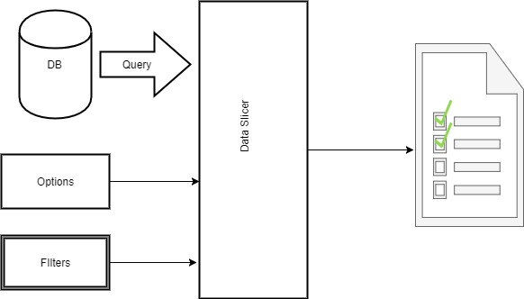
Data Slicer
For most experiments we have a certain focus on what kind of data we need and how the quality has to be. To get this focused data we provide the DataSlicer.
https://github.com/OpenDiabetes/OpenDiabetesVault-engine/wiki/Data-Slicing
Notes:
For data filtering we provide the Filter interface. Filters can be registered at processing services like the DataSlicer and have to implement the Filter interface. Multiple filters are combined with the logical "and" paradigm. As shown in the figure below, filters take a data array together with options. The filter will delete not matching data from the array and returns it together with a list of time spans where continuous data is present (this could be used to find the data in the complete array again)

Slide 35
Data Slicer- Implementation
Data slicer expects result in option value with Timestamp from a bunch of a filtered data.
To get the sliced data, program would expect parameters as option and Which Timestamp is needed from a bunch of results i.e. First of series or Mid of series of End of series. Filter filter = new TimePointFilter(startTime, 12);
DataSlicerOptions options = new DataSlicerOptions(60, FIRST_OF_SERIES);
DataSlicer instance = new DataSlicer(options);
instance.registerFilter(filter);
switch (options.outputFilter) {
case FIRST_OF_SERIES: tmpTimestamp = item.getKey();
break;
case MID_OF_SERIES: tmpTimestamp = generateMidPoint(lastResult, new Date((item.getValue().getTime() + item.getKey().getTime()) / 2));
break;
case END_OF_SERIES: tmpTimestamp = item.getValue();
break;
default:
throw new AssertionError("Unknown output filter");
}

Slide 36
Unit Testing

Slide 37
Unit Testing
With respect to thesis work, The entire project is divided in three main modules as Crawler, Uploader and Data slicer.
The plan for setting unit testing is bifurcated with respect to module.
Adding unit testing has not only helped us understanding modules more in depth but also significantly improved the code quality.
Especially in case of Data slicing algorithm, we were not exactly sure before hand how we need the output to appear. But using sample data set and writing unit test cases for it helped to visualize, what output we would achieve.

Slide 38
Conclusion
The framework in this thesis is basically built to solve problem of generating huge amount of medical data at bulk without repetitive human efforts.
Generating data from website posses challenges such as parsing HTML, checking login user and user's preferred language.
Depending on individual parameters, logic has been implemented.
The generated data posses challenge to extract exact information needed using different options and parameters hence Data slicers and filters are also implemented.
The current Thesis work focuses on extracting and uploading data from/to one particular website. In future if the need to generate data from even more multiple sources, this thesis work can be very well expanded to encapsulate different such sources.

Slide 39

Questions?

